Slide 1
There's Something in the Water! It's Energy Savings
Ron Burke
President and CEO

Slide 2
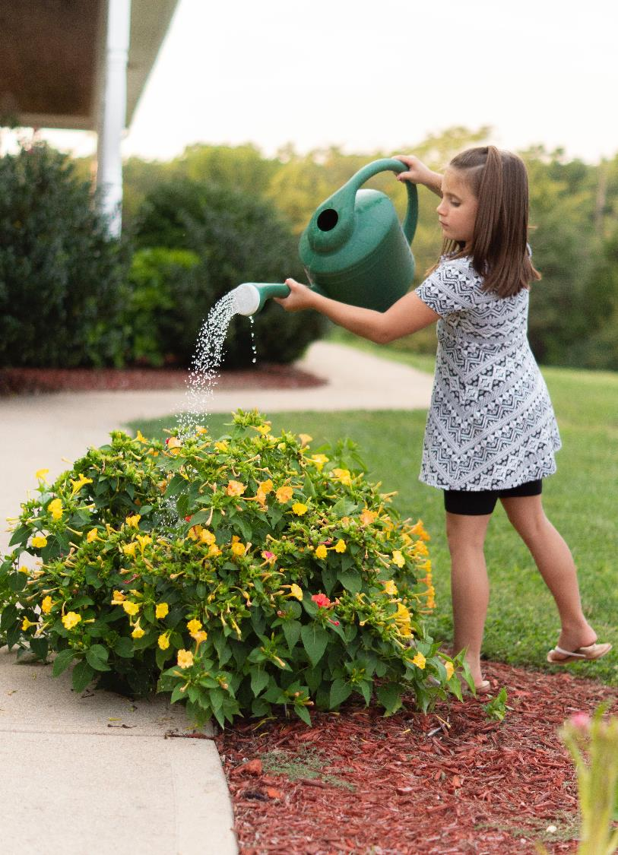
AWE: A Voice for Water Efficiency
Our mission is to promote an efficient and sustainable water future
530+ member organizations in 200 watersheds delivering water to over 50 million water users
A unique network of water efficiency experts and practitioners.
A forum for collaboration around policy, information sharing, education, and stakeholder engagement
AWE provides training, research, and other resources for water efficiency professionals
Visit allianceforwaterefficiency.org/membership to learn more
Notes:
For those who may not know AWE….

Slide 3
Who We Bring Together
Water suppliers (retail and wholesale)
Water planning agencies
Plumbing, appliance & irrigation manufacturers and retailers
Efficiency-focused businesses
Efficiency service providers
Environmental community
Energy community
Government (federal, state, municipal)
Academic representatives
Cultural institutions

Slide 4
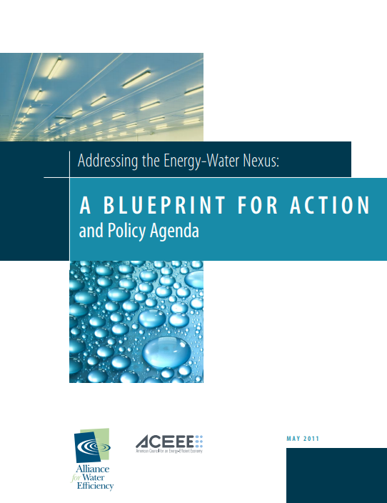
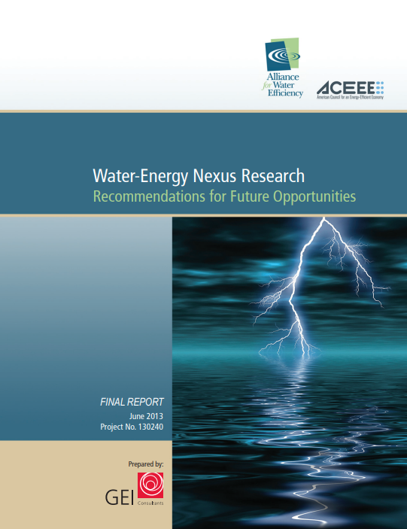
AWE’s Water-Energy Work
Our Energy-Water Objective: Encourage and build collaborative opportunities between water and energy providers to optimize energy and water savings.
Reports and Resources:
Addressing the Energy-Water Nexus: A Blueprint for Action and Policy Agenda (50 recommendations)
Water-Energy Nexus Research: Recommendations for Future Opportunities
Water-Energy Nexus Research Database
AWE Water Conservation Tracking Tool
Testimony before Senate Water and Power Subcommittee
Facilitating collaborative energy/water efficiency retrofit/replacement programs
Notes:
Blueprint: Lays the groundwork for future energy-water joint efforts and policy agenda for actions at the federal, state, local, and watershed levels
Recommendation for future opportunities white paper: An assessment into the status of research on the relationship and trade-off s between the water and energy sectors and identifies areas where additional research may be needed to facilitate decisions regarding effective research investments in this area

Slide 5
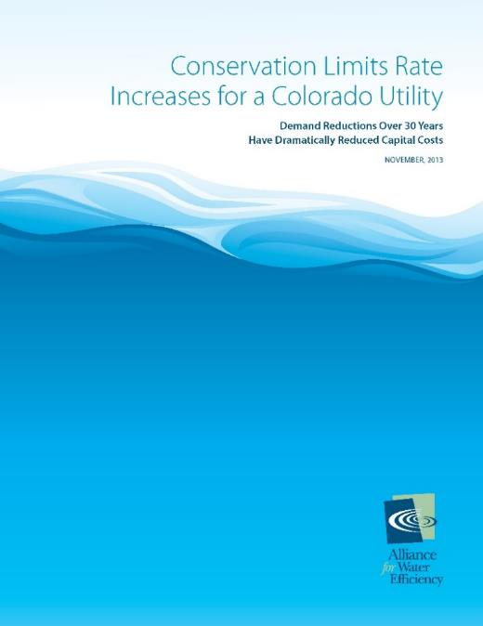
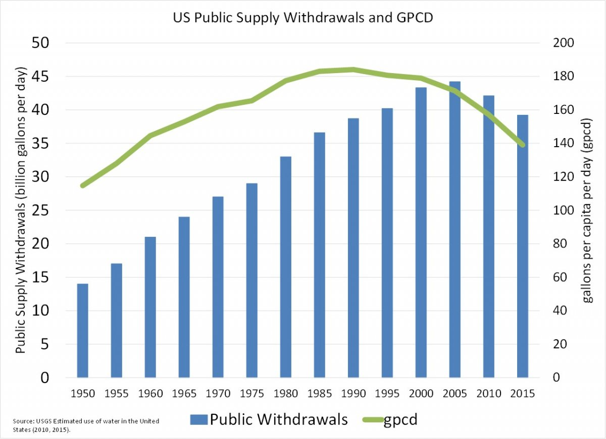
Water Efficiency/Conservation Fastest and Least Expensive Way to Save Water; also fights Drought and Climate Change and Lowers Water Bills
Ensures reliable water supplies: 1995 to 2020, the U.S. population grew by 63.2 million people with public water withdrawals essentially unchanged.
Tackles the root cause of climate change: water-saving strategies reduce the amount of energy used to heat, pump, and treat water, which in turn reduces emissions of heat-trapping carbon dioxide.
Protects our rivers, bays, and aquifers by limiting water withdrawals.
Save utilities and taxpayers money: minimizes need for infrastructure expansion
Saves consumers money: water efficient products can save an average family hundreds of dollars each year.

Slide 6
Water efficiency works…despite a lack of federal funding
Between 2000 and 2020, federal EERE investments dwarfed federal investments in water efficiency and water reuse by a ratio of approximately 80 to 1. (https://www.allianceforwaterefficiency.org/resources/analysis-federal-funding-2000-2020)
Only one federal water efficiency grant program – WaterSmart at USBR (and energy efficiency projects are also eligible!)
The federal government pays less than 5 percent of the cost for drinking water and wastewater (National Association of Clean Water Agencies).
Before 1987, the federal share of project costs was generally 55%.
No federal agency “owns” water efficiency/water supply reliability which undermines the potential for more federal $$.
USEPA focuses on water quality; WaterSense a very small program not even mentioned in EPA’s recent draft Strategic Plan
USBR focuses on water supply projects

Slide 7
Want to save energy and fight climate change? Try using less water
BY SAMMY ROTH. STAFF WRITER
MARCH 4, 2021

Slide 8
Water - Energy - Climate Nexus
Water Savings = Energy Savings = GHGs
End-user energy savings (reduction in the amount of energy needed to heat, cool, and pressurize water in homes and businesses)?
System-wide/embedded energy savings (reduction in energy used to collect, treat, and deliver water and collect and treat wastewater)
Hot and cold water energy savings

Slide 9
Water efficiency reduces the energy needed to collect, treat, and distribute potable water and wastewater
Source: California Energy Commission, 2005 IEPR

Slide 10
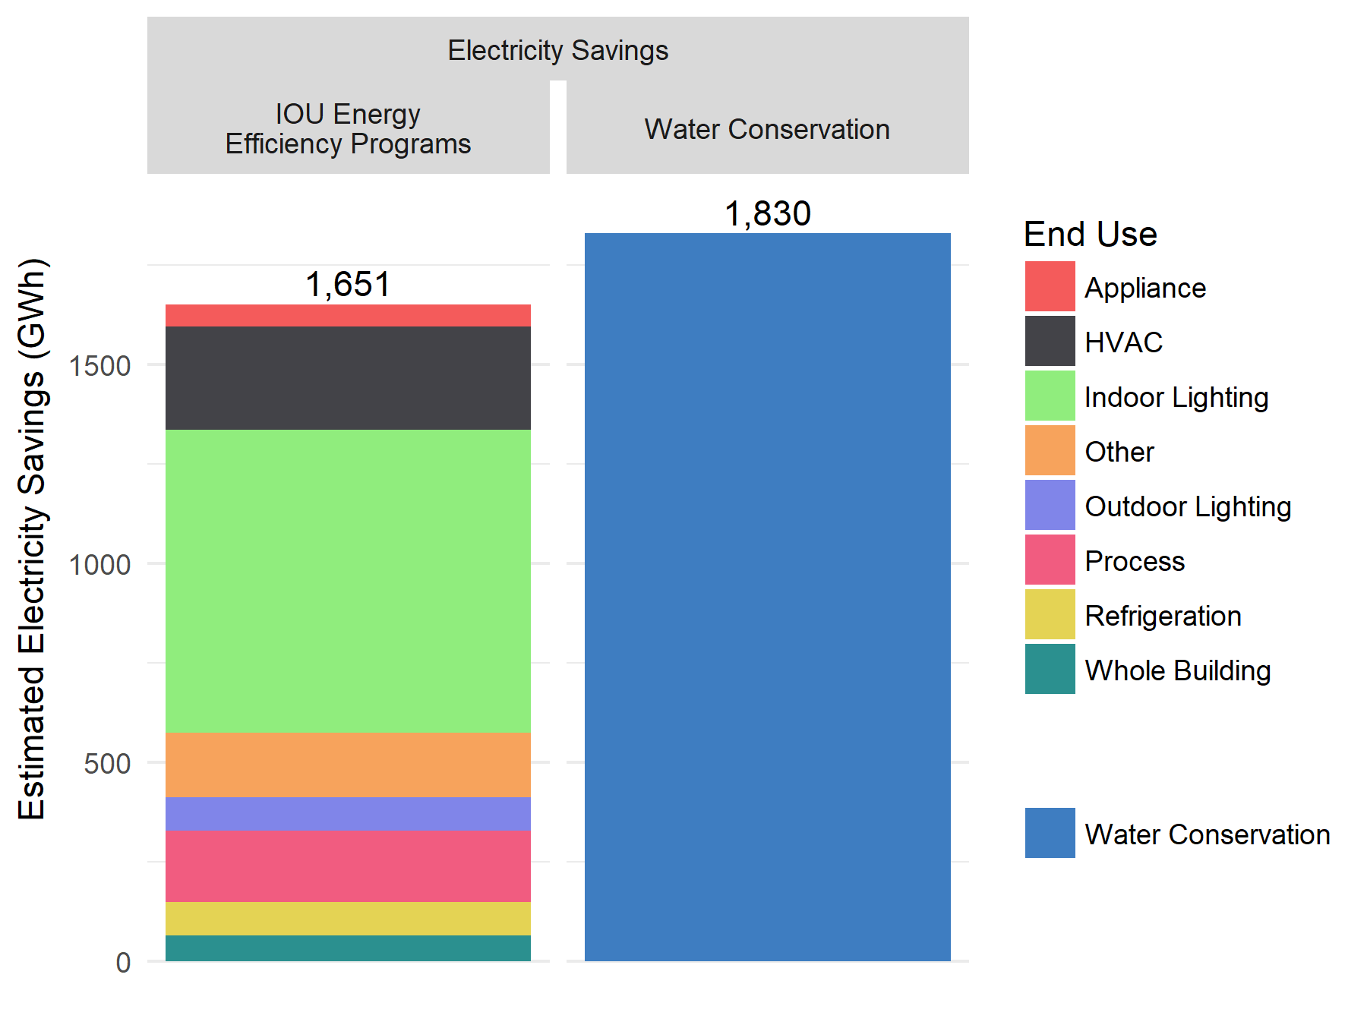
Estimated electricity savings from California statewide water conservation
programs vs. IOU EE programs (2015 – 2016 )

Slide 11
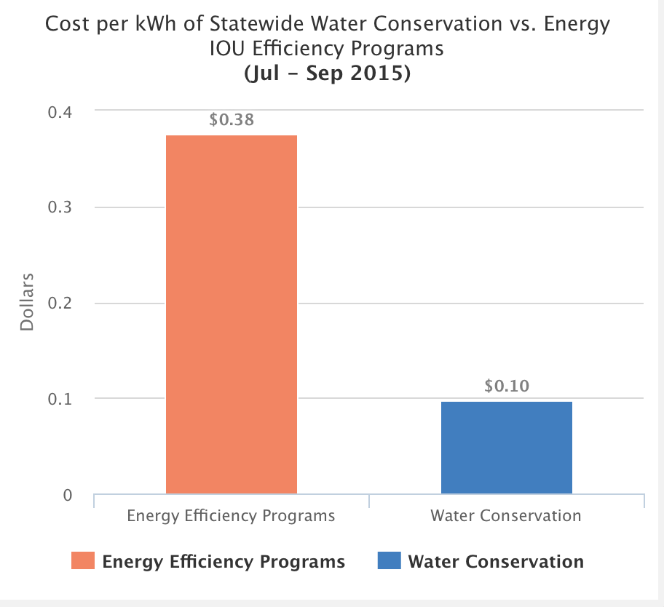

Slide 12
Supply source: State Water Project
8,140 kWh/AF (24,991 kWh/MG)
Supply source: Ground Water
2,890 kWh/AF (8,873 kWh/MG)
Supply source: Lake Water
2,926 kWh/AF (8,984 kWh/MG)
Implemented landscape conservation program
Able to eliminate State Water Project deliveries with major energy, cost savings
Notes:
Lake Arrowhead Community Services District: Small agency in California with 7700 connections

Slide 13
Embedded Energy in Water: Illinois
2018: Illinois became the only U.S. state to allow energy
utilities to claim energy efficiency credit for water
efficiency projects
Approved by the Illinois Commerce Commission
(update to the Technical Reference Manual (TRM) for
Energy Efficiency)
Makes cold water efficiency
Water Supply Energy Factor = 2,571 kWh/MG
Wastewater Treatment Energy Factor = 2,439 kWh/MG
Factors based, in part, on Water Energy Nexus Survey
Summary Report (2012), Illinois Section of the American
Water Works Association

Slide 14
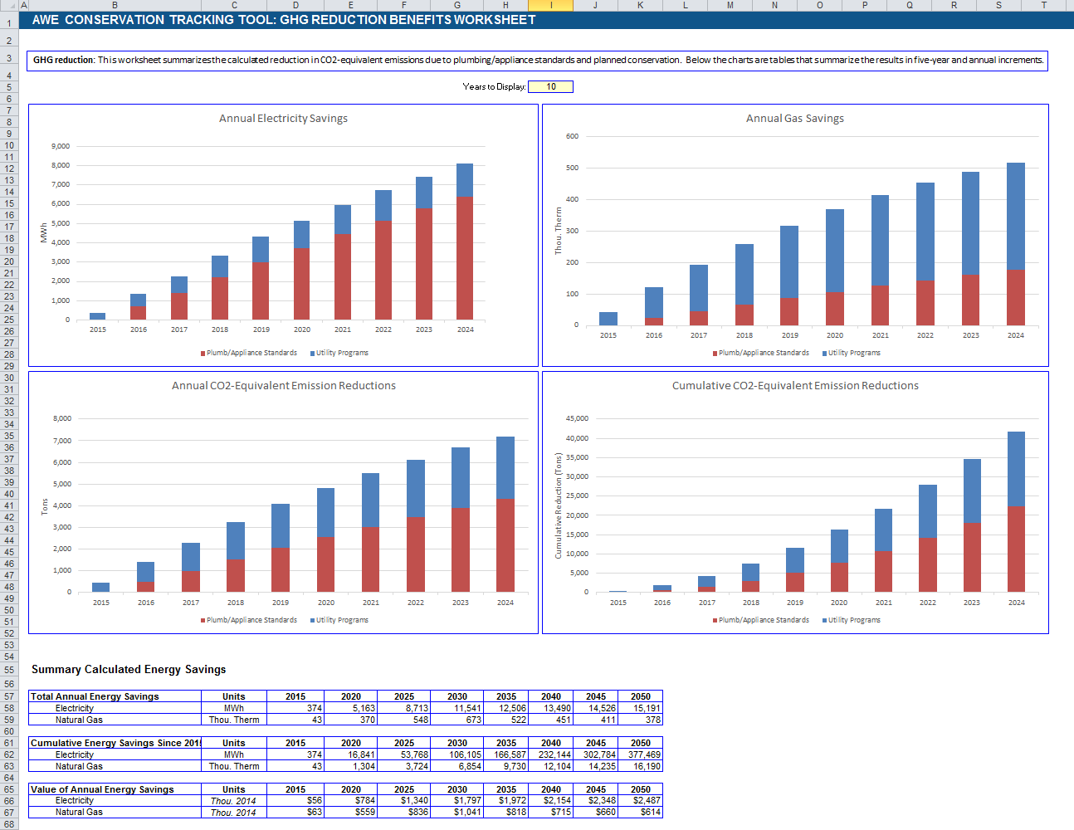
AWE’s water conservation tracking tool
Estimates Energy Savings and CO2 Reductions

Slide 15
Joint Water-Energy Efficiency Opportunities
Ensure that grants/programs/code changes, etc., to improve building energy efficiency address water efficiency as well
Multiple DOE programs where the following amendment could make a big difference: “that support energy and water efficiency…”
Combined water/energy audits
Combined retrofit/replacement/rebate programs (“piggy back”)
High efficiency plumbing fixtures and appliances
Irrigation systems
Landscape transformations
Commercial/Industrial/Institutional
Cooling tower efficiency improvements
Water/steam reuse
Process efficiencies
Leak detection/prevention
Inside buildings
Irrigation systems
Within the drinking water distribution system (water loss prevention)

